Slide 1
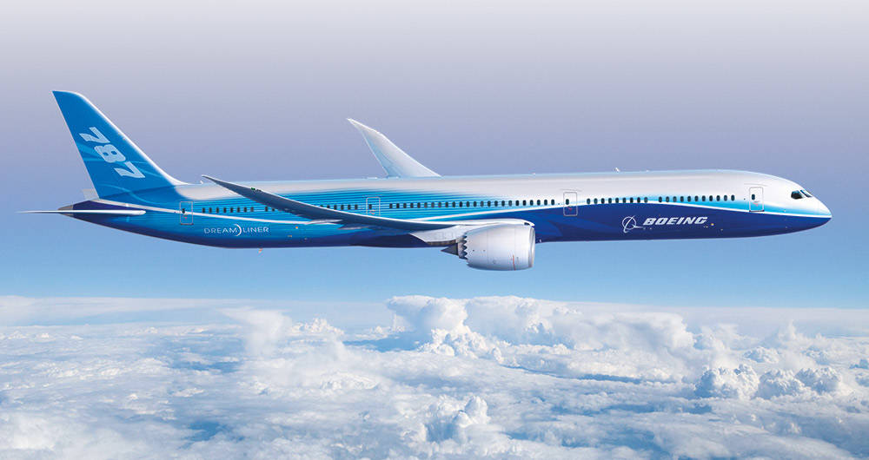
Dreamline
Finding the Cheapest and Most Comfortable Flight
Group 26- Brain Kopec, Cole Pearson, Harshal Patel, Nausherwan Tirmizi

Slide 2
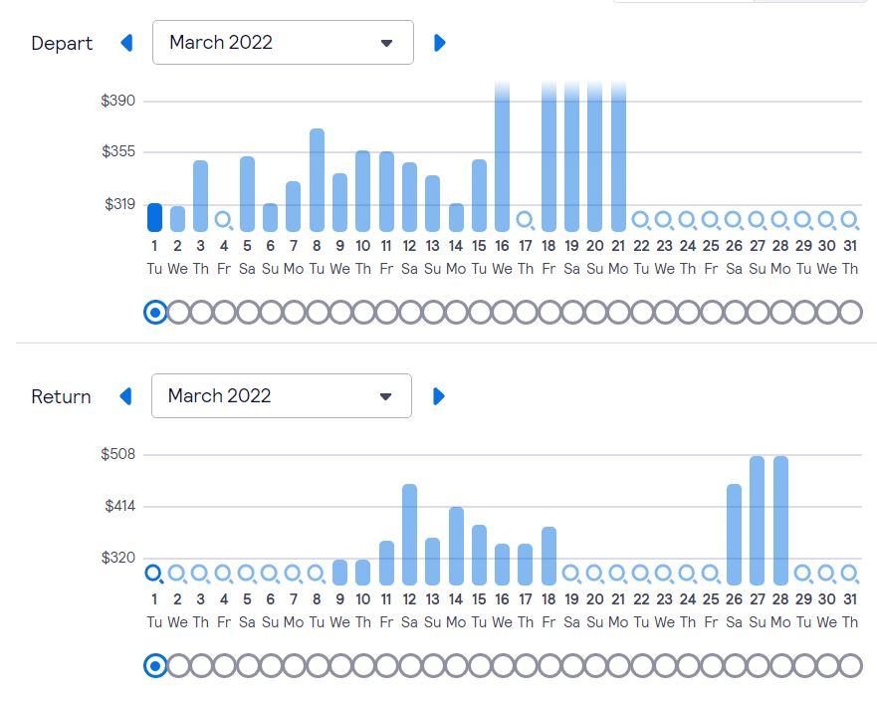
The Purpose of This Project - Find the Cheapest Seat
Prices fluctuate massively:
Date of departure and arrival
Airline differences
Third party ticketing agents
Compile prices and index the cheapest prices

Slide 3
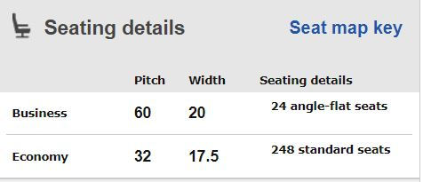
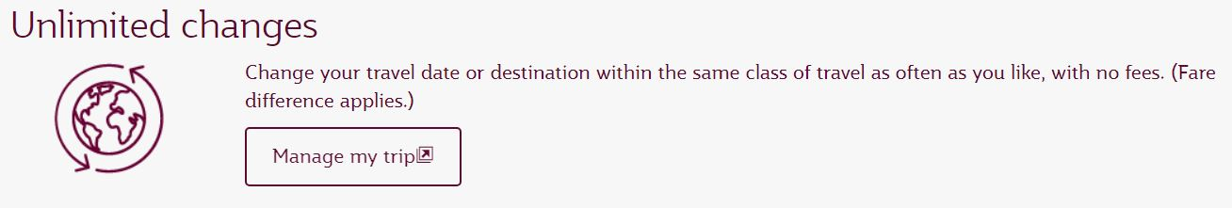
The Purpose of This Project - Find the most Comfortable Seat
The physical comfort of the seat:
Varying legroom by airline
Age of Airplane
Seat back entertainment
Cabin Pressure
Benefits of booking with a certain agent:
Ticket flexibility
Loyalty programs

Slide 4












The Current Competition… There’s a lot.

Slide 5
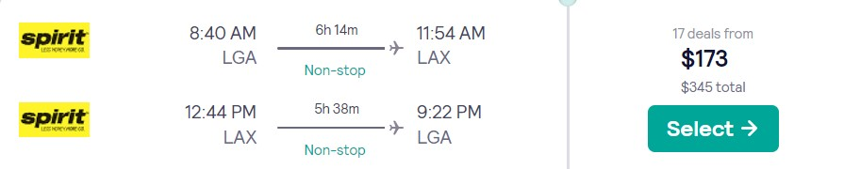
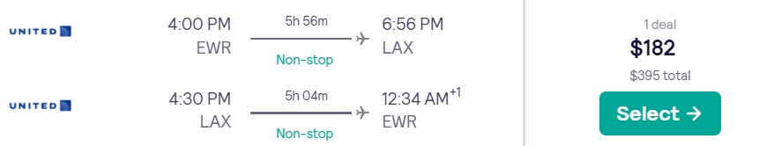
Carve Out A New Market
No other competitor has any metrics for comfort
Airline upgrades within the same ticket are expensive
Price difference between airlines can be minimal but the comfort can be maximal

Slide 6


28 Inches Legroom
THE SEATS DO NOT RECLINE
Beverages and snacks for purchase
No Internet
No AC Power
No Onboard Entertainment
Smaller Carbon Footprint
31 Inches Legroom
Beverages and snacks included
Internet available for purchases
Movies on demand through personal cell phone
Outlet and USB Ports

Slide 7

The Dreamline Score
Balance affordability and comfort to create a new metric: The Dreamline Score
Assign the value of a certain amenity
Changeable by user
Final Ticket Recommendation

Slide 8

Building The Dreamline Score
Ask the customer for the dates, origin and destination
API calls for ticket prices
Functionality already created by airlines and ticketing agents
API calls for aircraft information
Amadeus
Sabre
TravelPort
Factor in the data, create the dreamline score
Display the information on the website

Slide 9

Stakeholders
Client
Pay for web development
Work directly with programmers
Constant feedback/features, quality application
Customer
Flight passengers
Best price/comfortability
Accomodations
Hands on user
Adults/Young adults
Frequent flyers
Require little knowledge for use
Maintenance users / Service Technicians
Developers provide updates/bug fixes
Technical support via email
Notes:
The Client: The client will pay for the website to be developed. The programmers will work directly with the client so they can receive feedback on the website and possible features added.
The Customer: Customers that will use this product will be people who are flying and want to find the best price. It will also attract more people who want certain accommodations, like more leg room.
Hands on users of the product: The customers who use this will primarily be adults/young adults. The user will not need much knowledge to use this website as it will be straight forward. The users who regularly use this service will be the ones who frequently fly.
Maintenance users and Service Technicians: The developers will provide any updates or bug fixes throughout the life of the product. There will also be technical service support via email through the website.

Slide 10
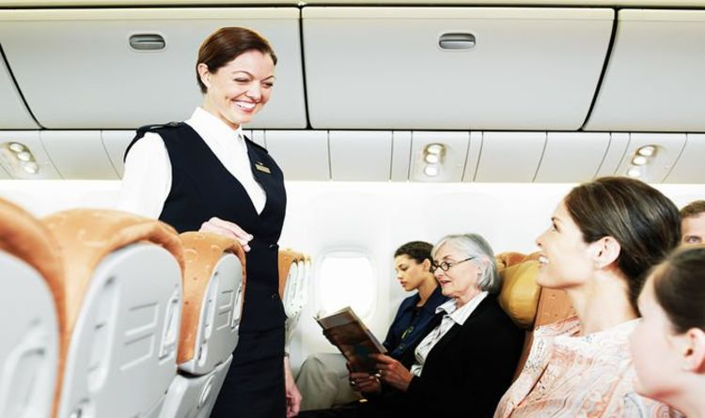
Stakeholders (cont)
Other Stakeholders
Marketing experts promoting website
Business analysts - identifying needs
Web developers
Legal team
User Participation
User feedback
Reviews
Priorities assigned to users
Frequent users
Secondary users
Providing feedback
Notes:
Other Stakeholders: There will be marketing experts to help promote website. There will be business analysts that help identify needs for developers and client. There will be web developers who create the website. There will be a legal team helping the developers.
User Participation: Users will participate throughout the development of the project. They will provide feedback to features they'd like us to implement. They will also give feedback on each version of the website.
Priorities assigned to users: Key users are people who provide feedback and use the website regularly and the developers. The secondary users are less frequent users who do not provide feedback. The unimportant users are users who do not user the website so do not have valid feedback.

Slide 11
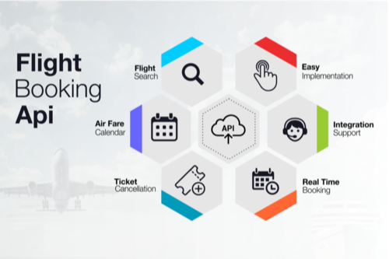
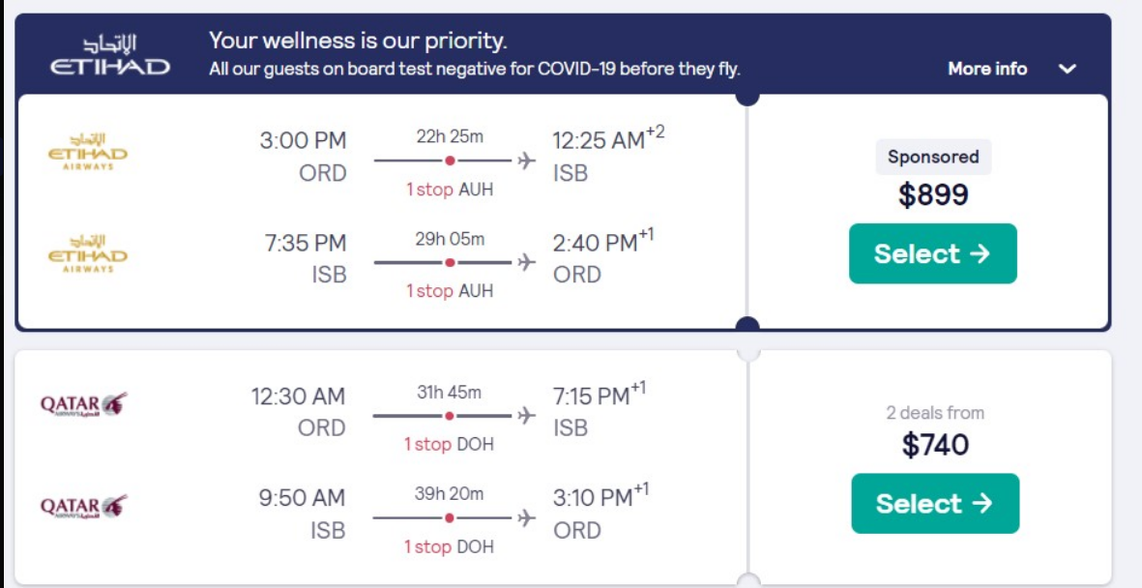
Constraints
Solution Constraint
Web based application
Better accessibility
Better user interface
Collaborative Applications:
Collaborate with Google Ads
Source of revenue
Use of cloud services
Cost/Performance/Security
Collaborate with airlines
sponsorship from competitors
Notes:
Cloud services - will reduce the cost of data storage and give performance benefits in terms of calculations, improve security rather than creating our own system of keeping the data secure. Allows use to scale the application to manage multiple airlines
Collaborate with airline- for sponsored listings to provide advertising for competitor airlines
must give score based on customer preference

Slide 12
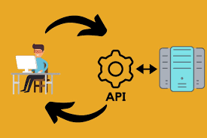
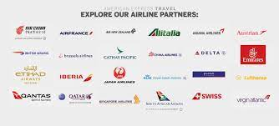
Constraints (cont)
Schedule Constraints
Up to date prices from API’s
Accuracy, customer satisfaction
Future releases to expand internationally
Variety, provide services for international flights ASAP
Up to date aircraft information
Changes in aircraft availability/configuration
Live Dreamline Score
Each ticket for a particular airline
Simple/Easy to understand
Based on specific aircraft properties

Slide 13
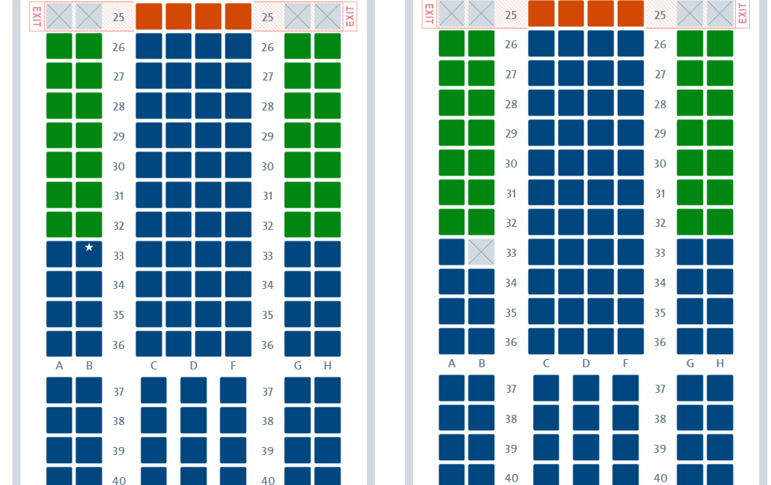
Naming Conventions and Definitions
Configuration
The overall properties of an airplane seat
Leg room, relative seat position, etc.
Ticketing agent
The group from which an airline ticket is purchased
Variable prices between different agents
Can be the airline itself, or a third party seller
Dreamline Score
The score shown to the customer that we assign to an airline ticket based on different factors such as price and comfort in order to provide that customer with the best options

Slide 14
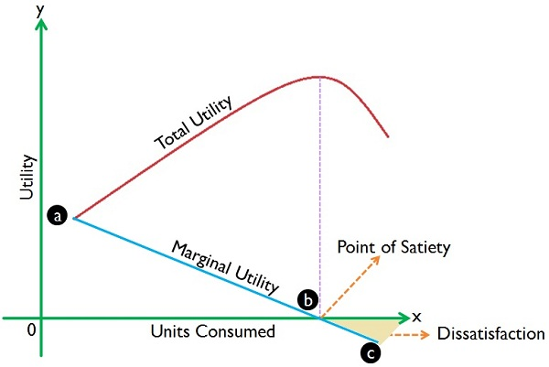
Relevant Facts and Assumptions
Facts
The average cost of flight to a customer is 1.3cents/mile
Customers want the most reasonable price for the most desirable outcome.
Assumptions
We have access to all relevant data, such as plane models, seat configurations, perks, etc.
People are willing and able to seek out a method weigh their options when it comes to buying plane tickets
The gathering and consolidation of this data is fully legal

